Slide 1


The evolving world of peer review
Ginny Barbour
Director, Australasian Open Access Strategy Group (AOASG)
Advisor, Office of Research Ethics and Integrity and Library, Queensland University of Technology, Brisbane
@openaccess_anz
www.aoasg.org.au

Slide 2
Credit for peer review - Publons
Preprints
Triaging review invites

Slide 3

What’s the one essential tool? (hint, you’ve heard it earlier…)

Slide 4

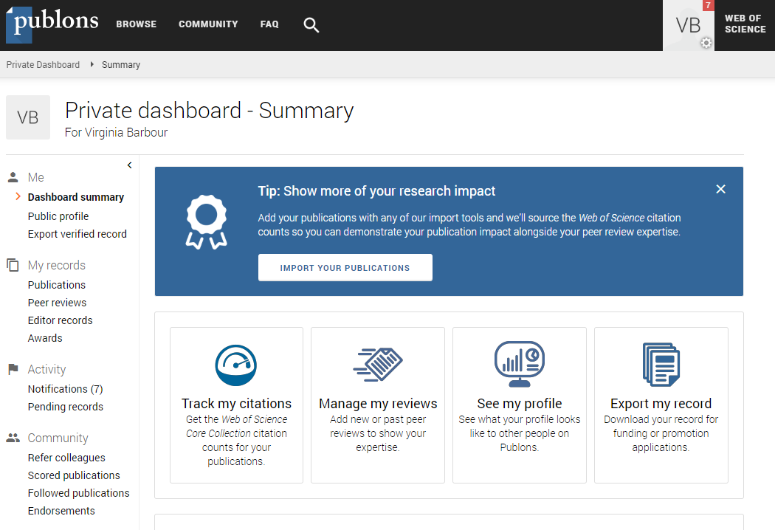
Credit for traditional peer review
https://publons.com/

Slide 5
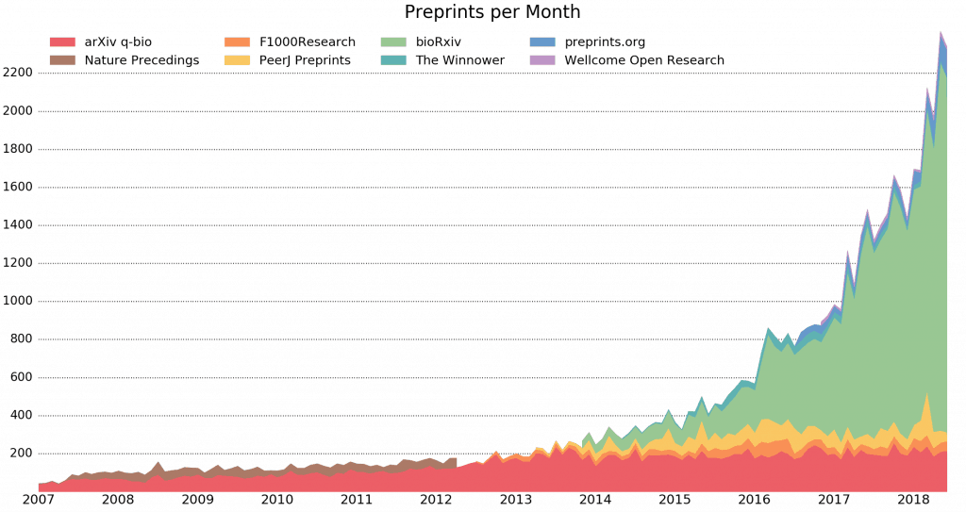
Preprints – the fastest growing area of publishing
https://asapbio.org/preprint-info/biology-preprints-over-time

Slide 6
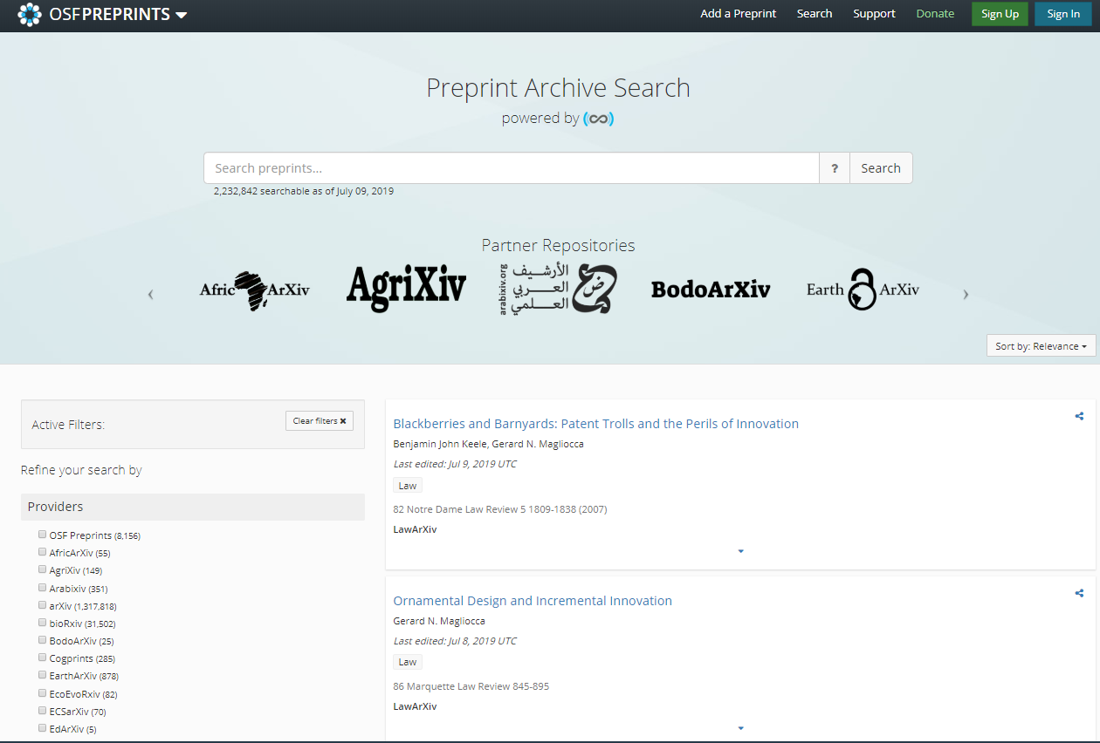
Where to find preprints
https://osf.io/preprints/discover

Slide 7
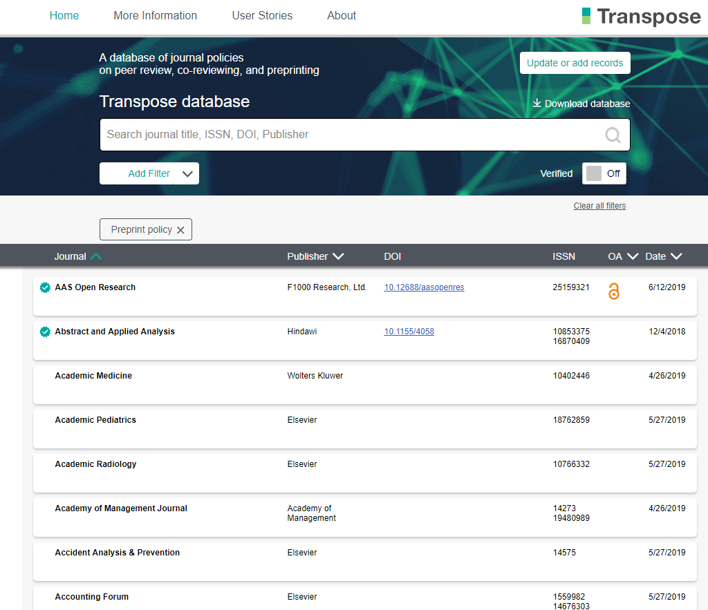
Where to find information on policies
https://transpose-publishing.github.io

Slide 8
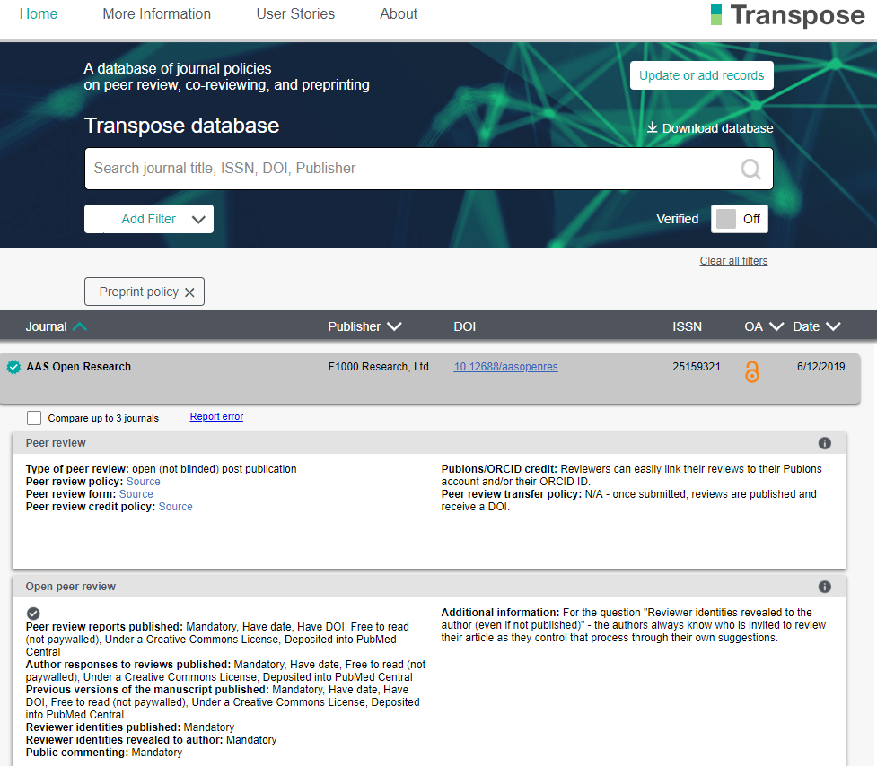

Slide 9
Actions on peer review
Go to Publons https://publons.com/
Sign in, or sign up
Or explore your institution to see who is reviewing what
Go to a preprint site and browse preprints and/or policies
http://asapbio.org/
https://osf.io/preprints
https://transpose-publishing.github.io/

Slide 10
Triaging review invites
Research Integrity and Peer Review Editorial Office <em@editorialmanager.com>
RIPR-D-18-00004
XXX Self-Plagiarism Research Literature:
Dear Ginny,
I would like to invite you to review the above manuscript which has been submitted to Research Integrity and Peer Review. Further details including the full abstract can be found at the end of this email.
If you are able to review this submission please click on this link:
https://ripr.editorialmanager.com/l.asp?i=11973&l=KCSW8G1D
If you are unable to review this submission please click on this link:
https://ripr.editorialmanager.com/l.asp?i=11974&l=3H55KR0X
We ask reviewers to return their report within 14 days of agreeing to review, however if you need more time please do let us know as we may be able to arrange an alternative deadline.
We operate an open peer review process for this journal in order to give peer reviewers credit for their work and to ensure accountability. Reviewers’ names are included in their report which means that authors will see the reviewers' names along with their comments, and the reading public will see the reviewers' identity and reviews if the manuscript is published. By agreeing to provide a report please understand that reviewer reports will be made available under an Open Access license Creative Commons CC-BY license (http://creativecommons.org/licenses/by/4.0/) if the manuscript is published.
Reviewers are also expected to keep manuscripts confidential as outlined in our editorial policies: http://www.biomedcentral.com/about/editorialpolicies#Confidentiality
You are requested to submit your review online by using the Editorial Manager system which can be found at:
https://ripr.editorialmanager.com/
Best wishes,
YYY

Slide 11
Triaging review invites
Research Integrity and Peer Review Editorial Office <em@editorialmanager.com>
RIPR-D-18-00004
XXX Self-Plagiarism Research Literature:
Dear Ginny,
I would like to invite you to review the above manuscript which has been submitted to Research Integrity and Peer Review. Further details including the full abstract can be found at the end of this email.
If you are able to review this submission please click on this link:
https://ripr.editorialmanager.com/l.asp?i=11973&l=KCSW8G1D
If you are unable to review this submission please click on this link:
https://ripr.editorialmanager.com/l.asp?i=11974&l=3H55KR0X
We ask reviewers to return their report within 14 days of agreeing to review, however if you need more time please do let us know as we may be able to arrange an alternative deadline.
We operate an open peer review process for this journal in order to give peer reviewers credit for their work and to ensure accountability. Reviewers’ names are included in their report which means that authors will see the reviewers' names along with their comments, and the reading public will see the reviewers' identity and reviews if the manuscript is published. By agreeing to provide a report please understand that reviewer reports will be made available under an Open Access license Creative Commons CC-BY license (http://creativecommons.org/licenses/by/4.0/) if the manuscript is published.
Reviewers are also expected to keep manuscripts confidential as outlined in our editorial policies: http://www.biomedcentral.com/about/editorialpolicies#Confidentiality
You are requested to submit your review online by using the Editorial Manager system which can be found at:
https://ripr.editorialmanager.com/
Best wishes,
YYY

Slide 12
Triaging review invites
Invitation from editorial office - Int J Biomechanics and Movement Science biomechanics@vibgyorpress.com
Dear Dr. Ginny Barbour,
Greetings from our journal!
We cordially invite you to join as an Editorial board member for our journal, International Journal of Biomechanics and Movement Science. It is an open access, peer reviewed journal involving the study of various biomechanical aspects of movement science.
Here I present the scope of the journal but not limited to: Neural Disease and Immunology, Kinesiology and Applied Physiology, Nutrition, Rehabilitation, Psychological Statistics.
You have been invited because of your contribution and recognized works in this field. Upon your acceptance, you are requested to send a recent photograph, your C.V, Biography (150 words), Research Interests for our records.
We would be happy to provide any further information about our journal.
We will be waiting for your positive mail.
With thanks,
ZZZ
Managing Editor
Editorial Office | International Journal of Biomechanics and Movement Science
1805 N Carson Street, Suite S
Carson City, NV 89701, USA

Slide 13
Triaging review invites
Invitation from editorial office - Int J Biomechanics and Movement Science biomechanics@vibgyorpress.com
Dear Dr. Ginny Barbour,
Greetings from our journal!
We cordially invite you to join as an Editorial board member for our journal, International Journal of Biomechanics and Movement Science. It is an open access, peer reviewed journal involving the study of various biomechanical aspects of movement science.
Here I present the scope of the journal but not limited to: Neural Disease and Immunology, Kinesiology and Applied Physiology, Nutrition, Rehabilitation, Psychological Statistics.
You have been invited because of your contribution and recognized works in this field. Upon your acceptance, you are requested to send a recent photograph, your C.V, Biography (150 words), Research Interests for our records.
We would be happy to provide any further information about our journal.
We will be waiting for your positive mail.
With thanks,
ZZZ
Managing Editor
Editorial Office | International Journal of Biomechanics and Movement Science
1805 N Carson Street, Suite S
Carson City, NV 89701, USA

